Slide 1
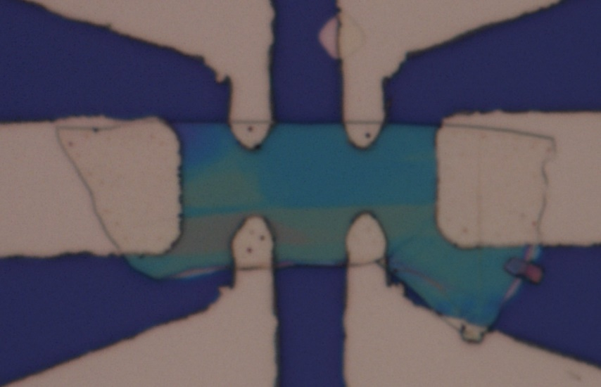
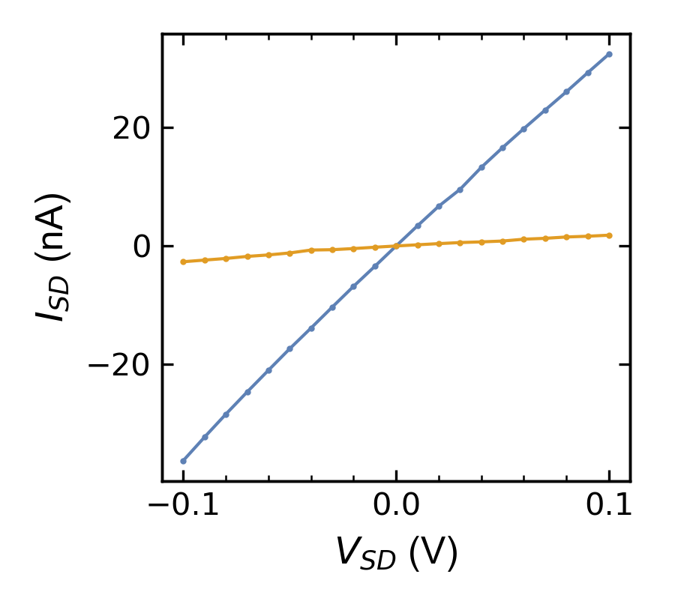
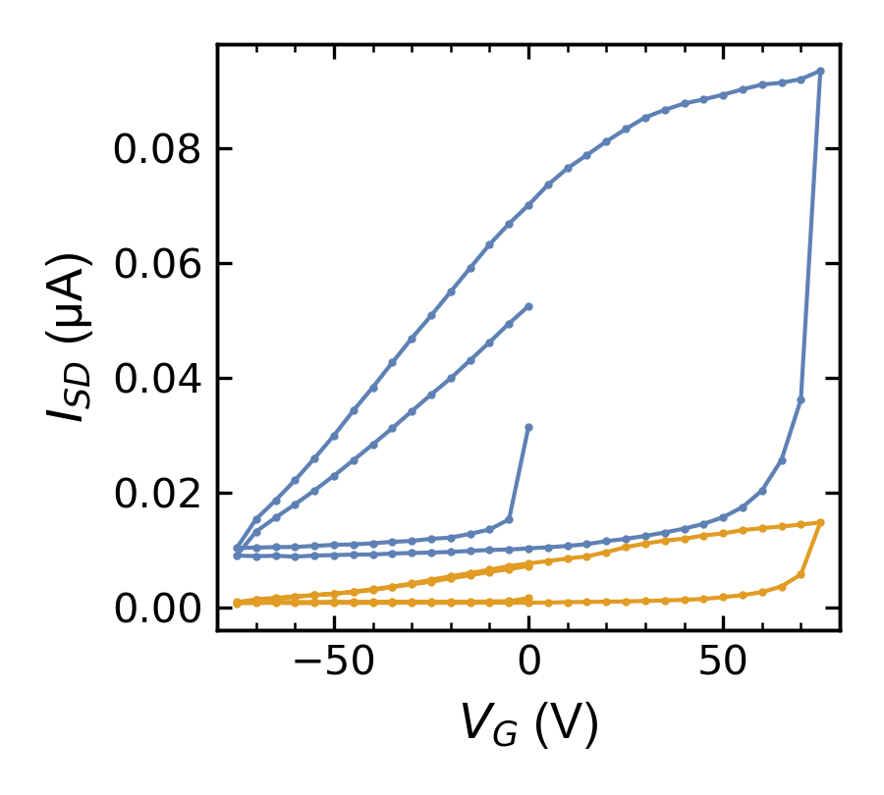
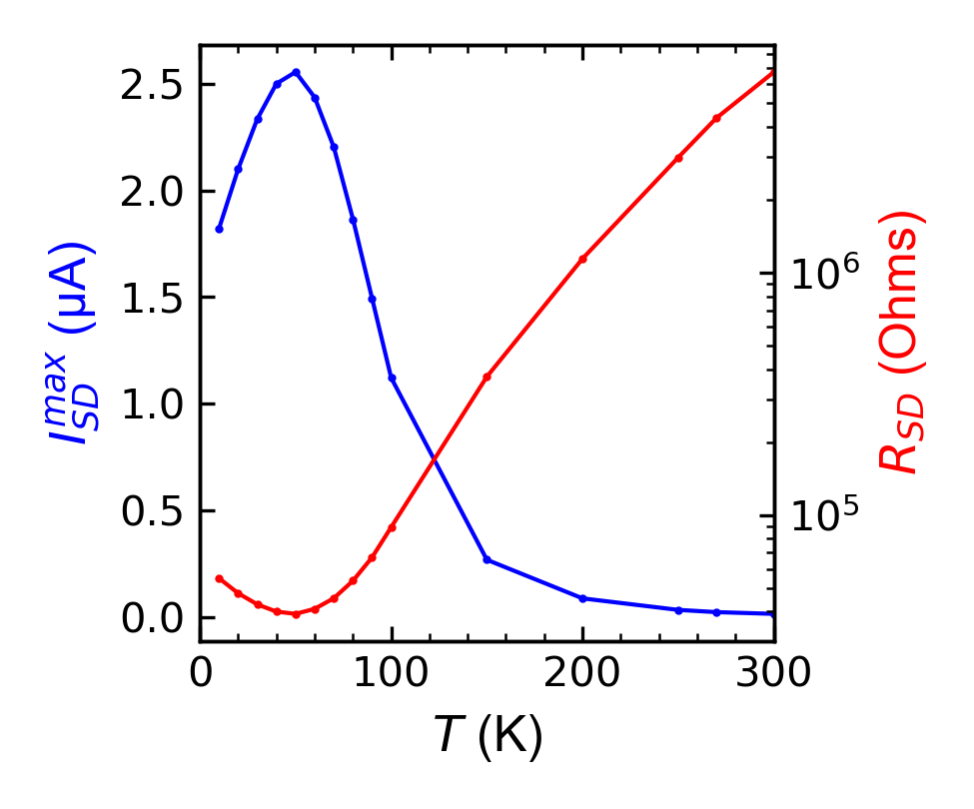
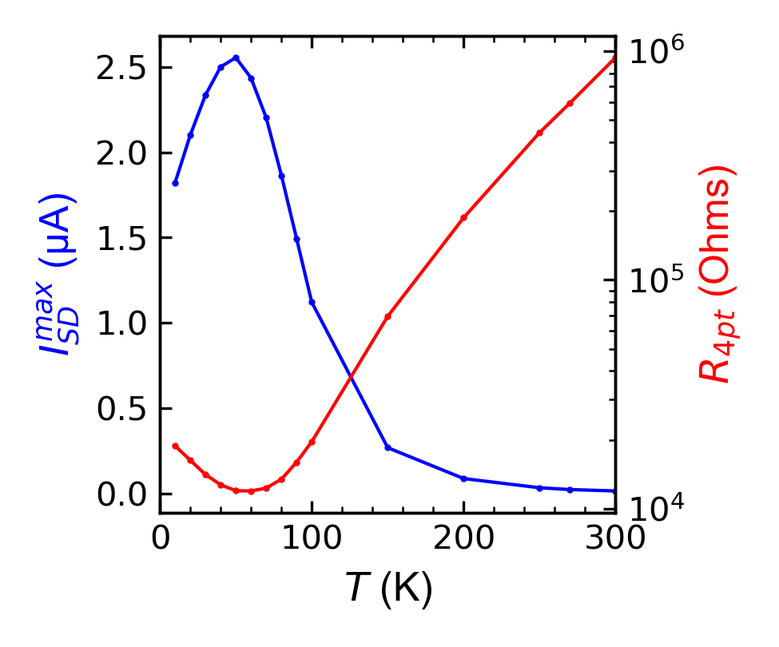
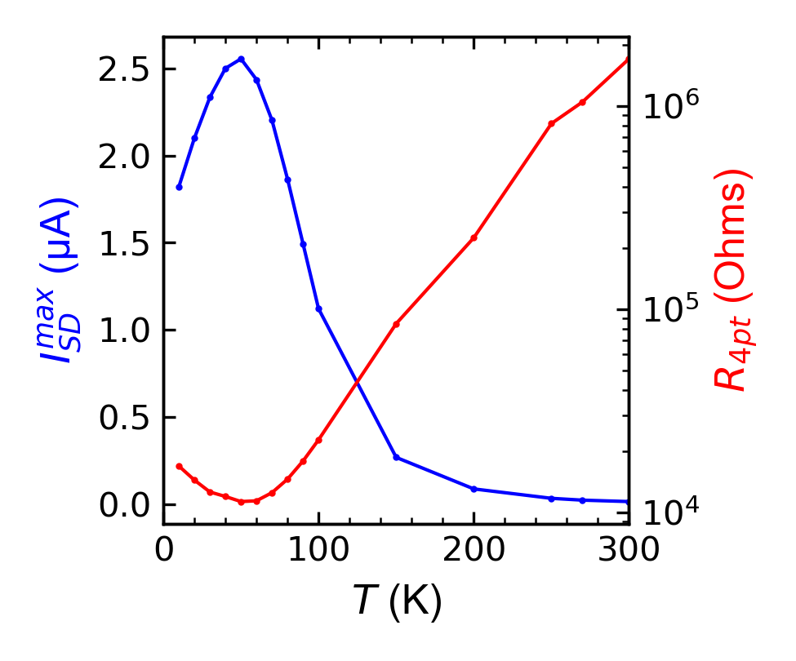
JR190919_03, In₂Se₃
300K pre/post heating
V_{SD} = .1V
pre
Heating was done for 1hour at 400K in high vacuum
pre
post
post
V_{G} = 75V, V_{SD} = .1V

Slide 2
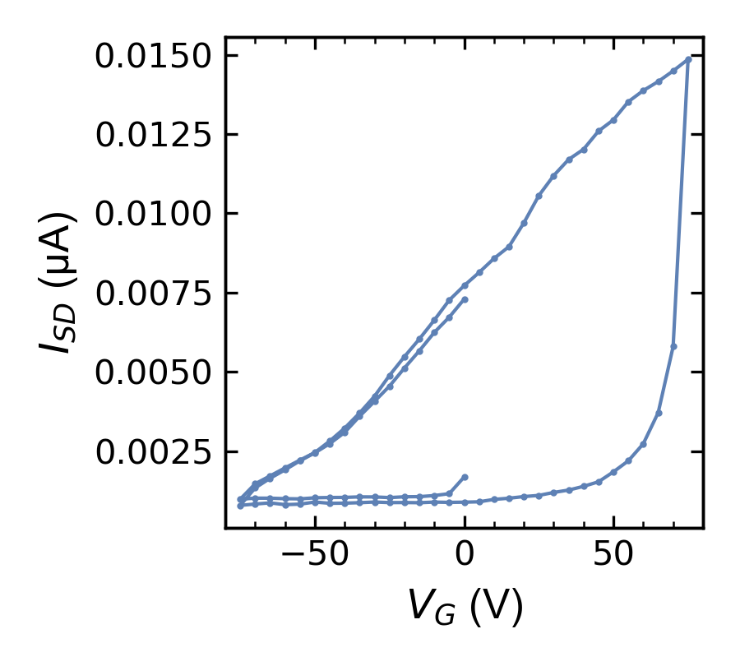
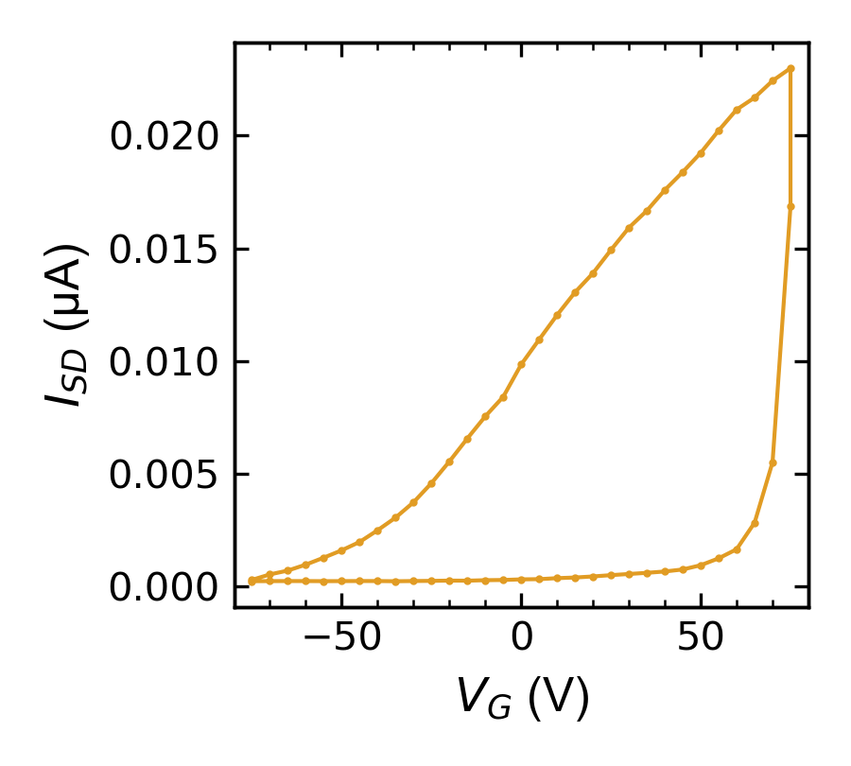
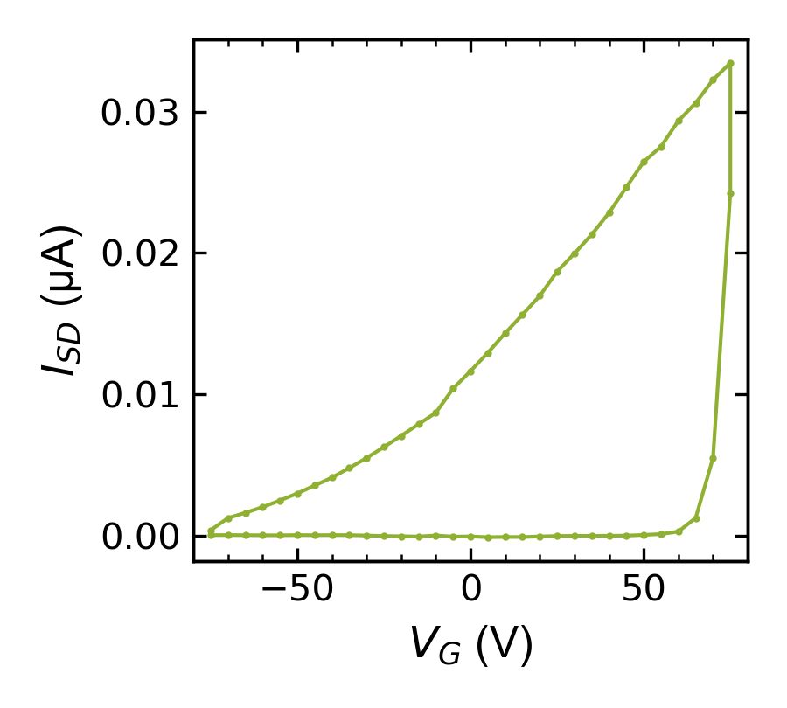
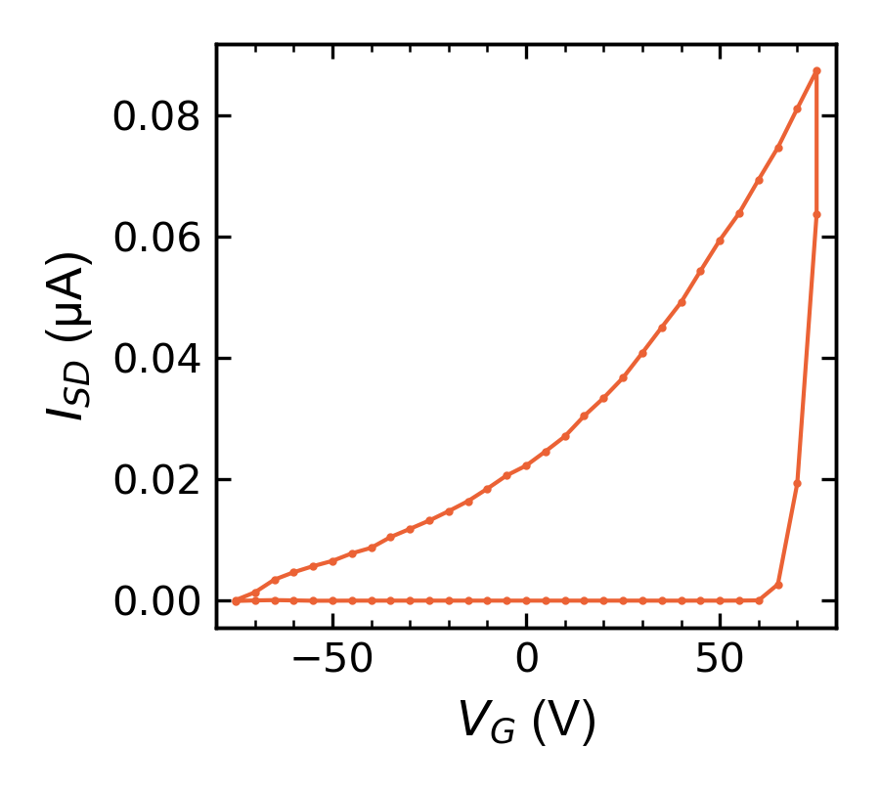
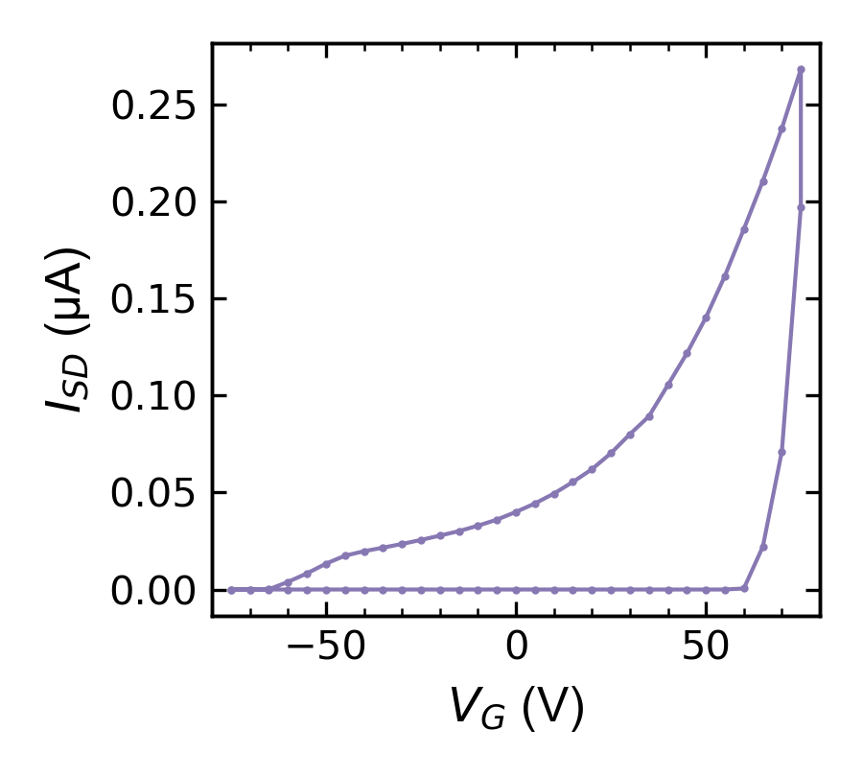
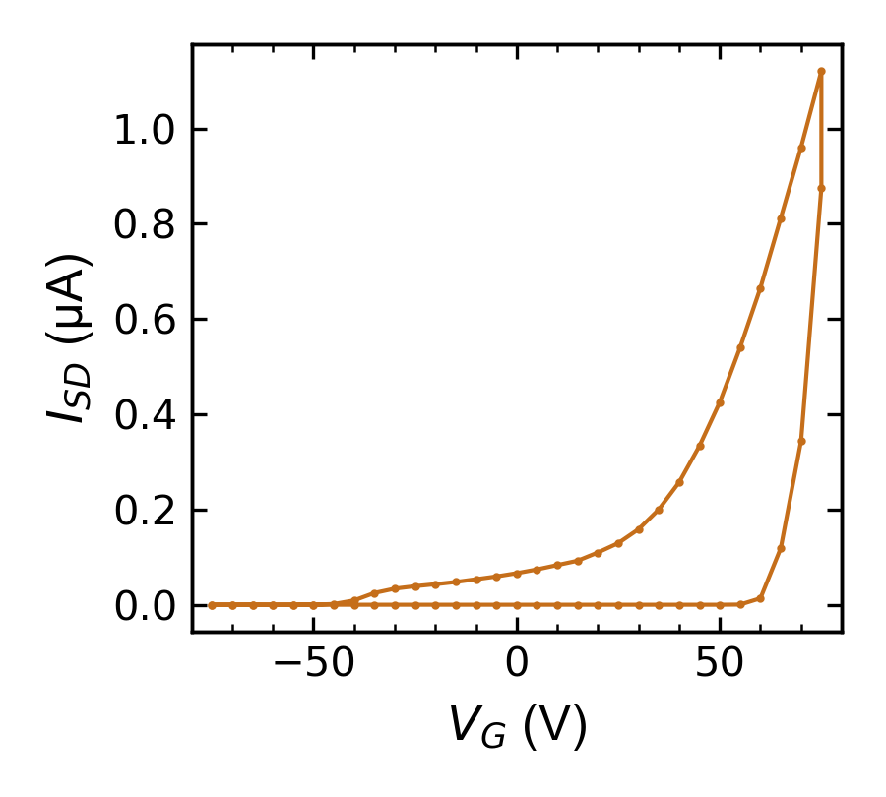
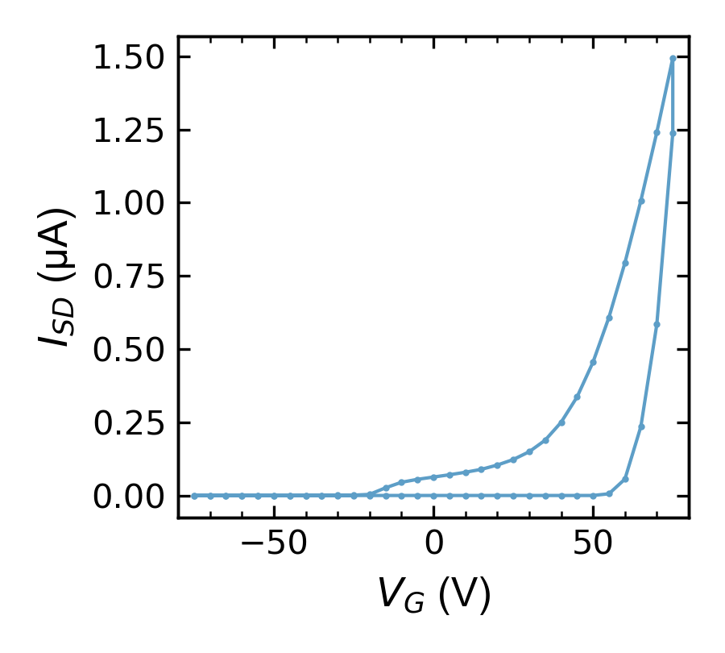
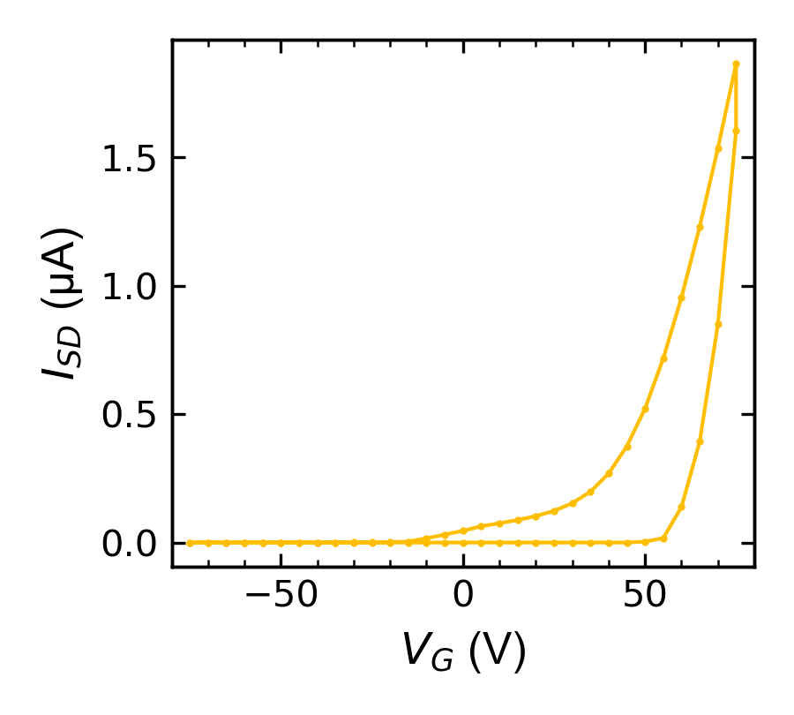
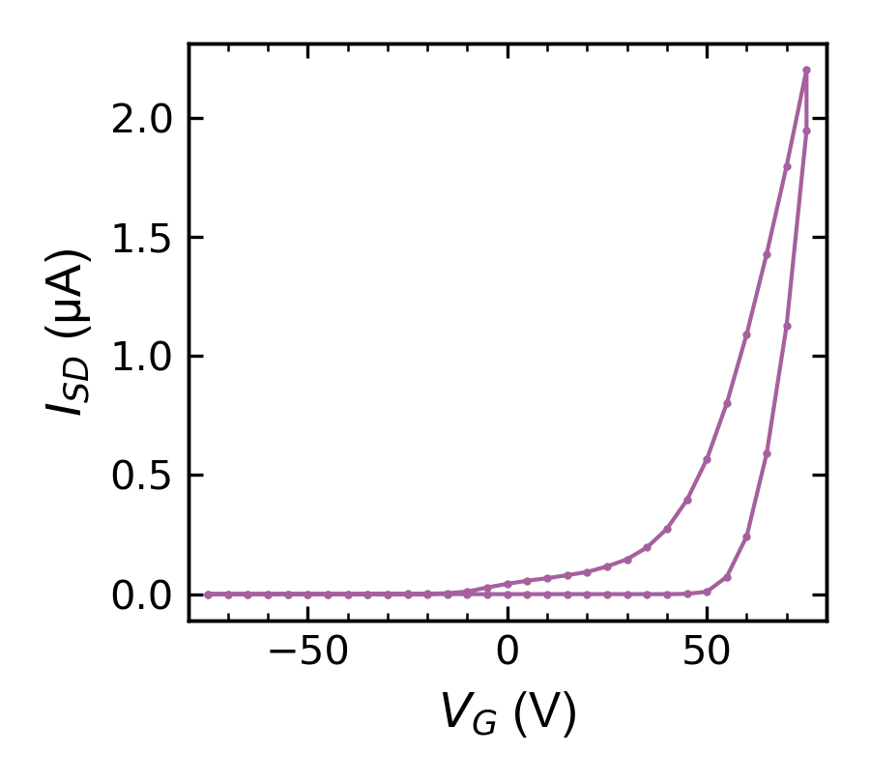
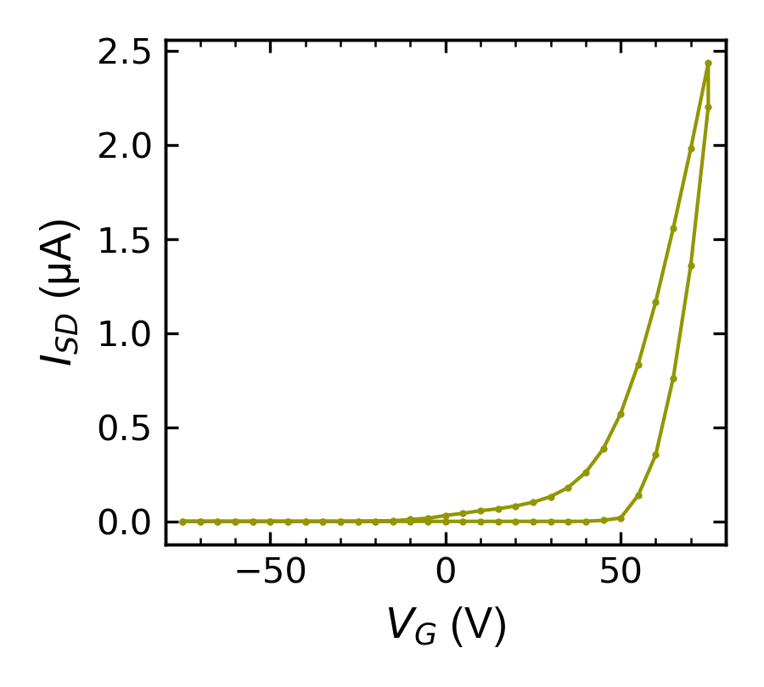

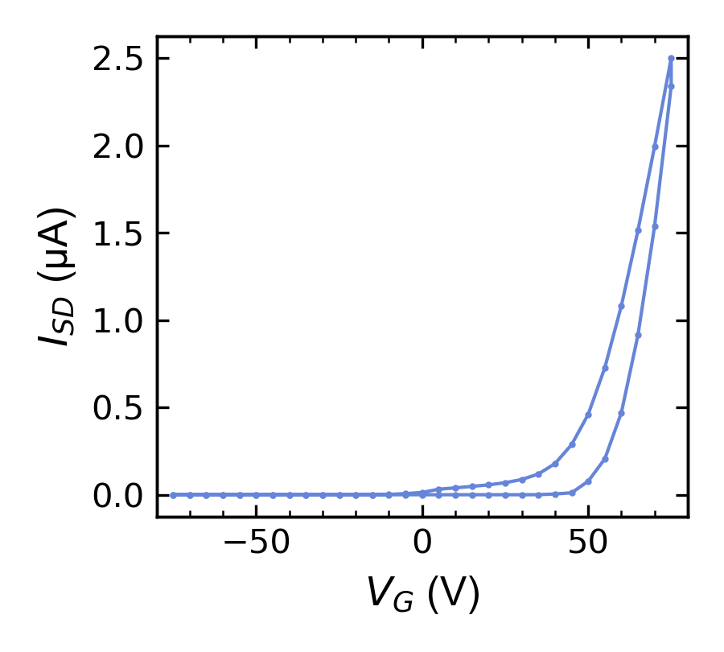
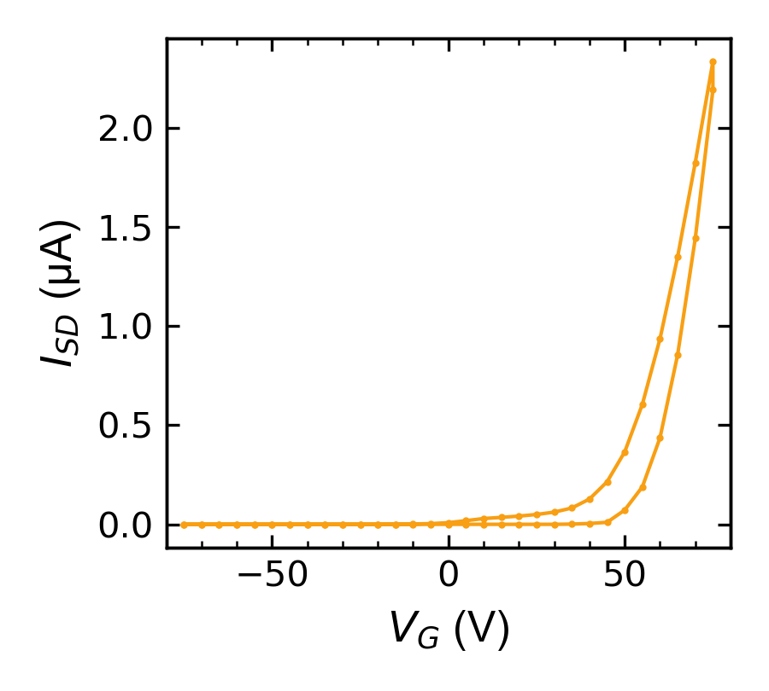
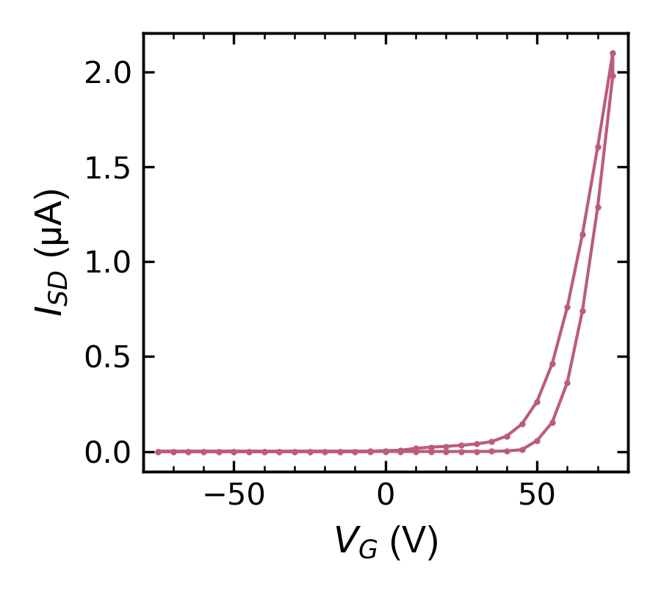
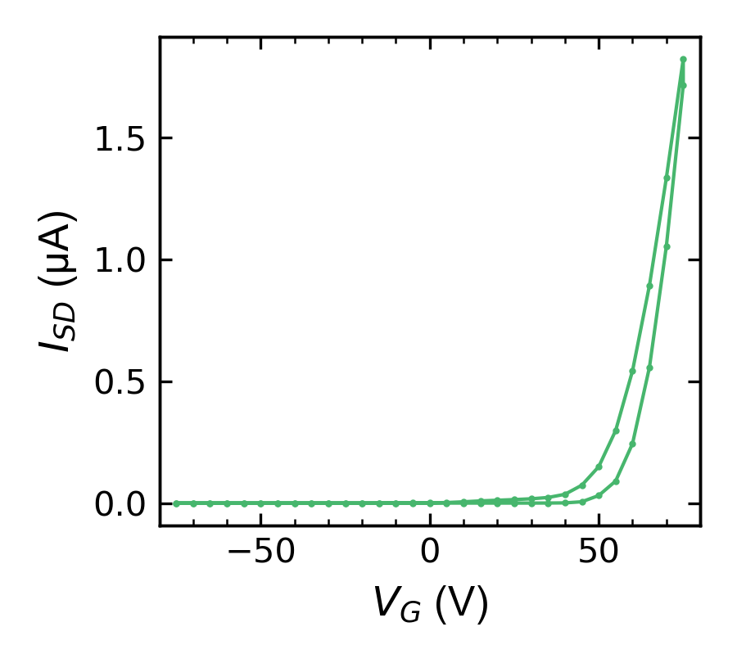
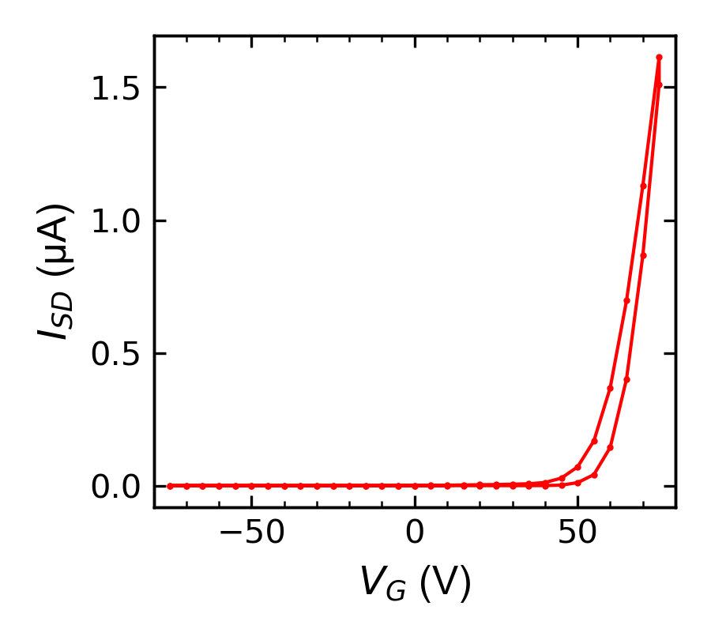
300K
270K
250K
200K
150K
100K
90K
80K
70K
60K
50K
40K
30K
20K
4K
10K

Slide 3
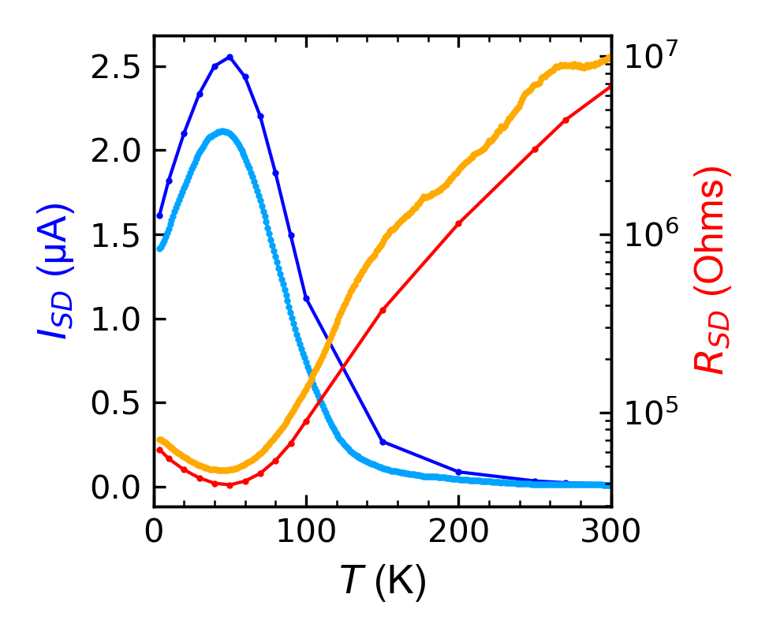
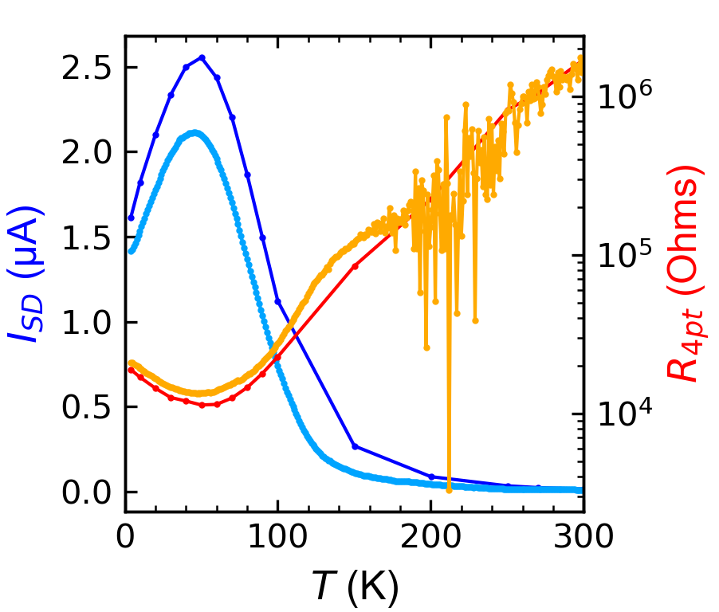
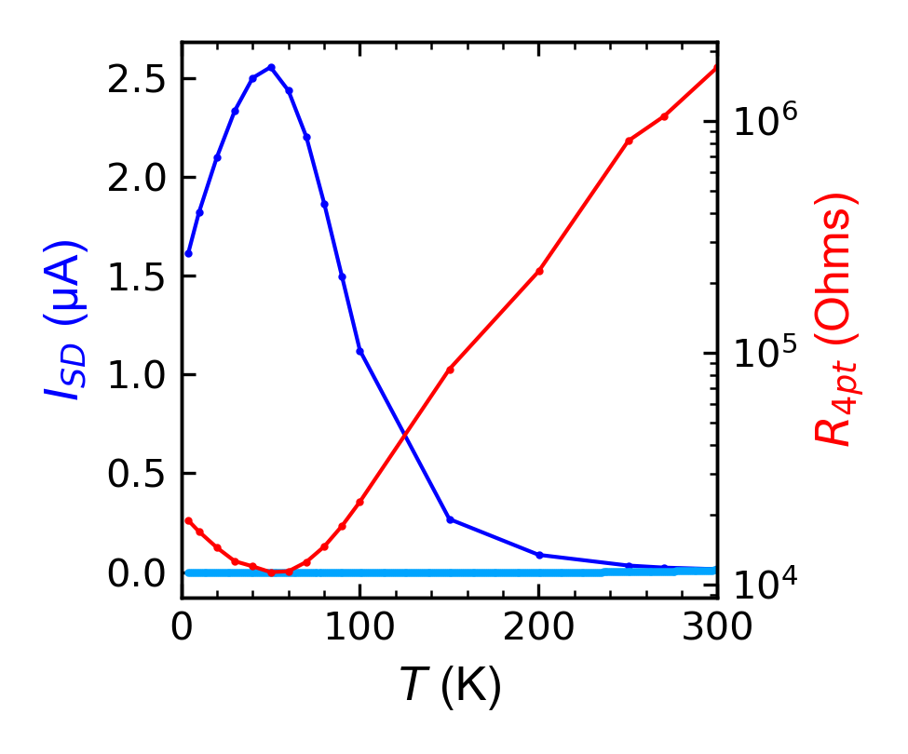
Warming 4K->300K
and
cooling 300K->4K
Both plots show max loops at V_{g} = 75V with V_{SD} = .1V
Left is 2pt, right 4pt
cooling current is so low resistance is not shown
Loop
Warm
Loop
Loop
Warm
Warm
Warm
Loop
Loop
Loop
Cool

Slide 4
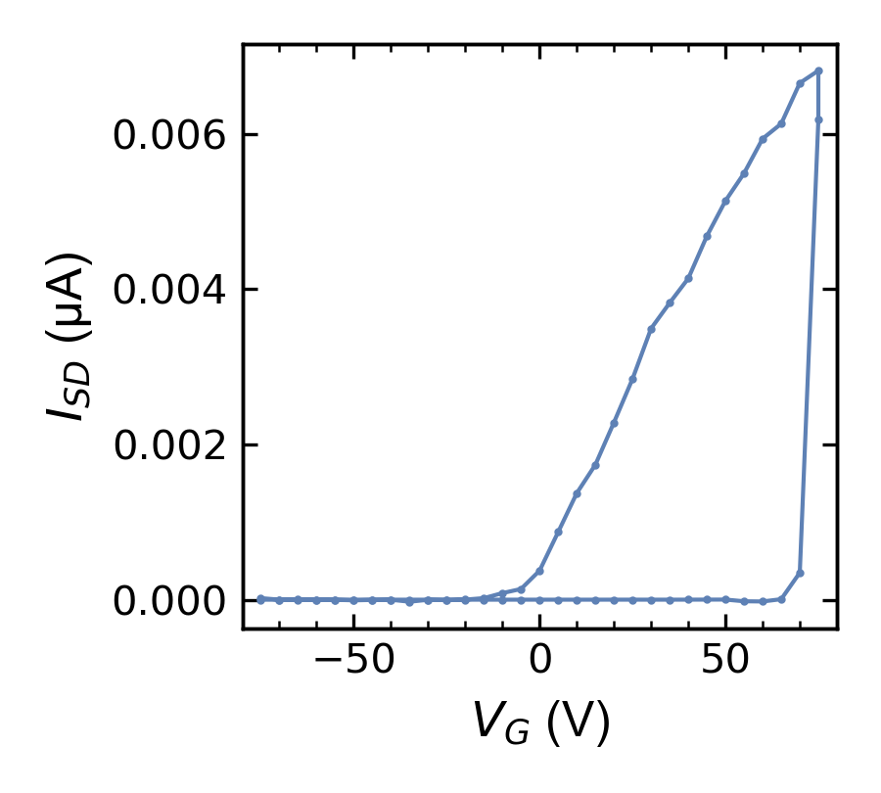
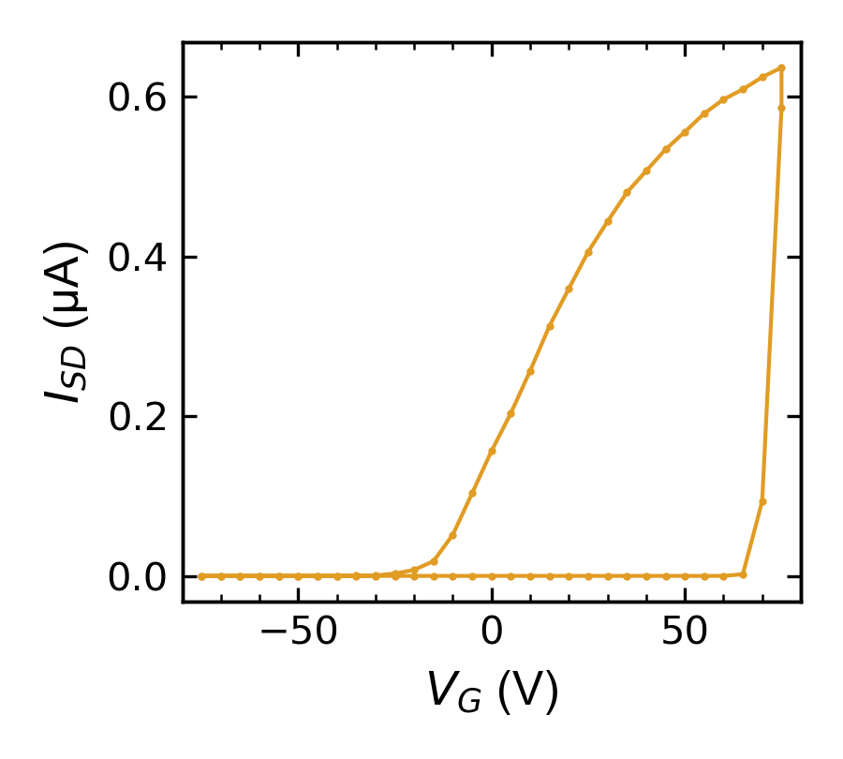
4K, SD = .1V, cooled at 0V
4K, SD = .1V, cooled at 75V
4K, SD = 1V, cooled at 75V

Slide 5
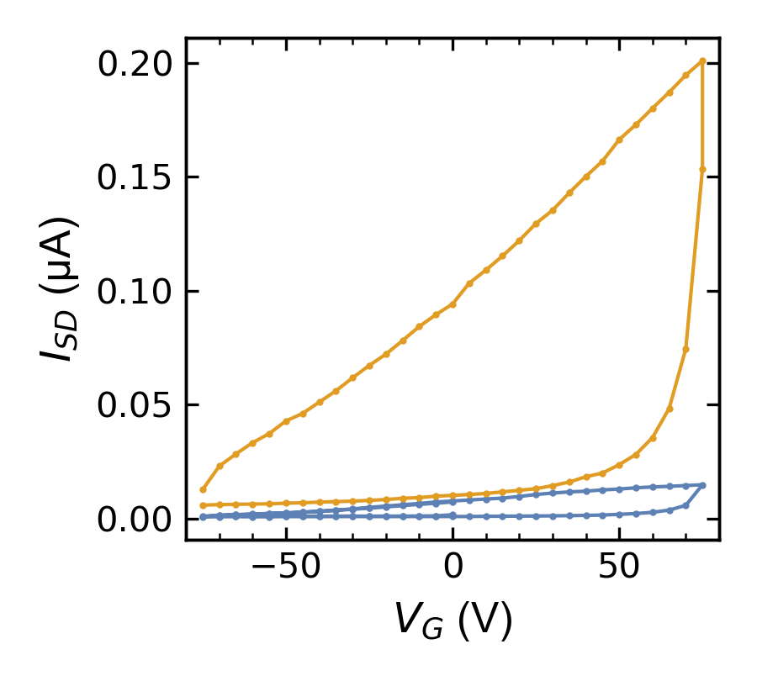
300K
V_{SD} = 1V
V_{SD} = .1V

Slide 6
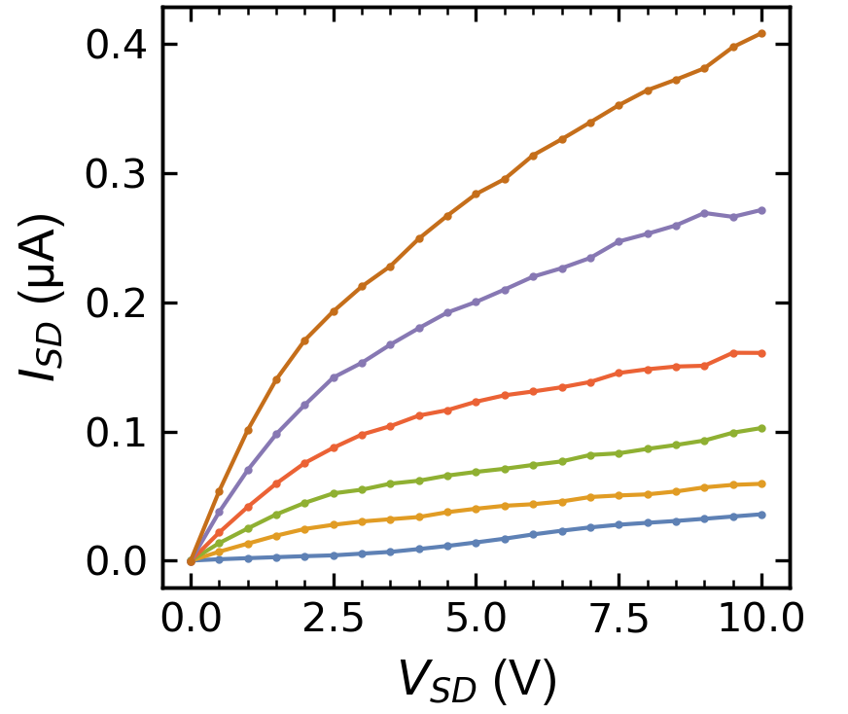
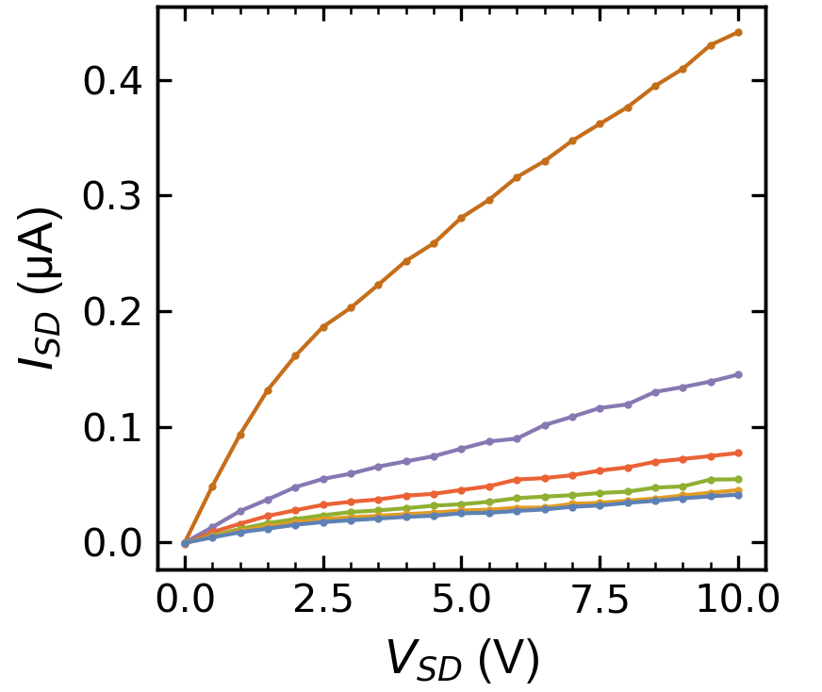
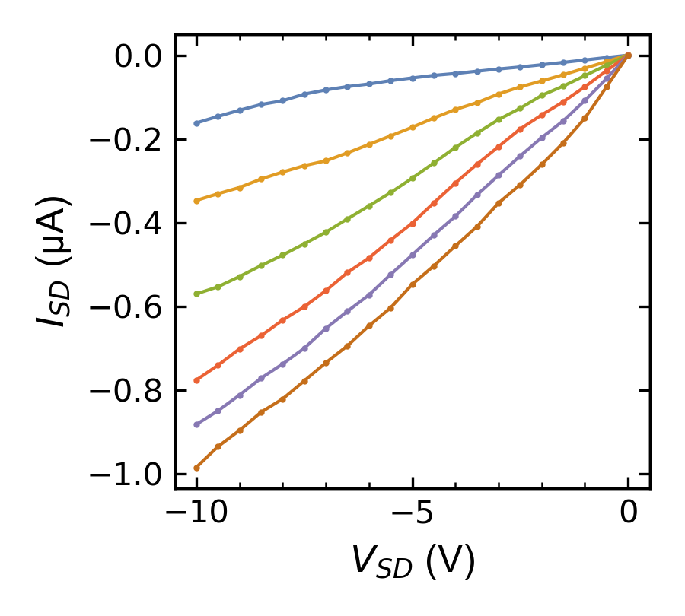
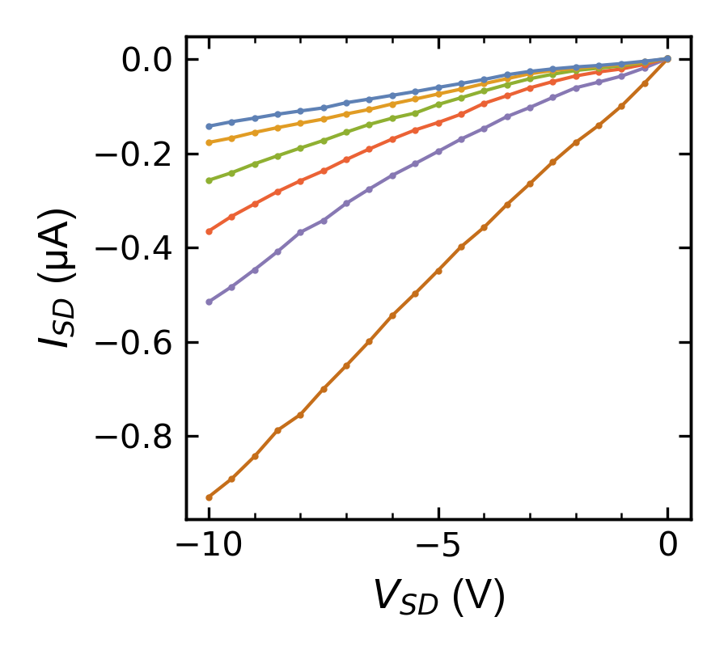
300K
25V increments
from -75V to 75V
Increasing V_{G}
Decreasing V_{G}
Increasing V_{G}
Decreasing V_{G}

Slide 7
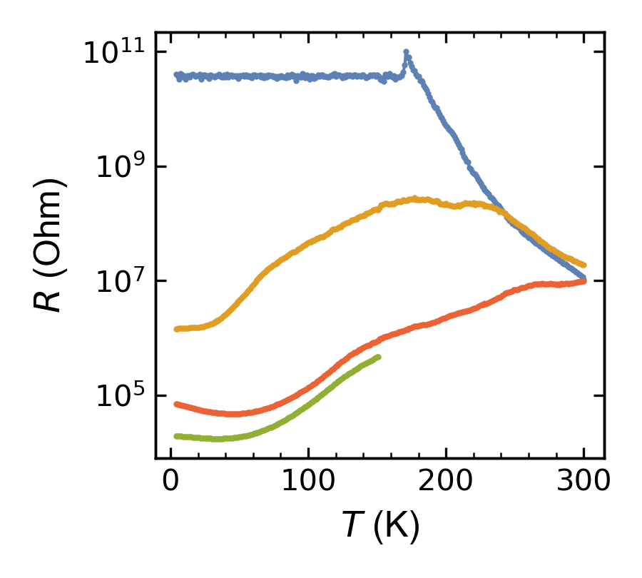
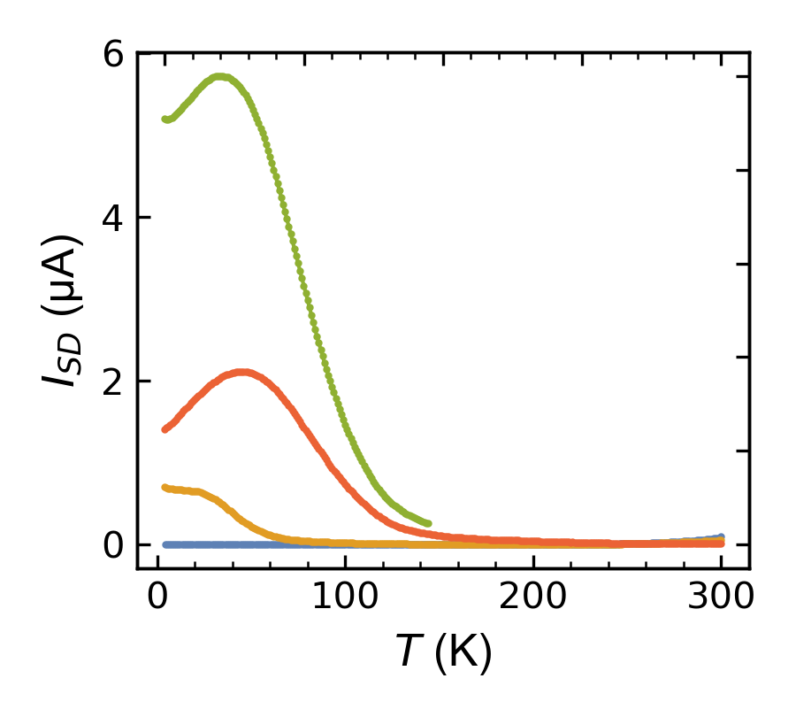
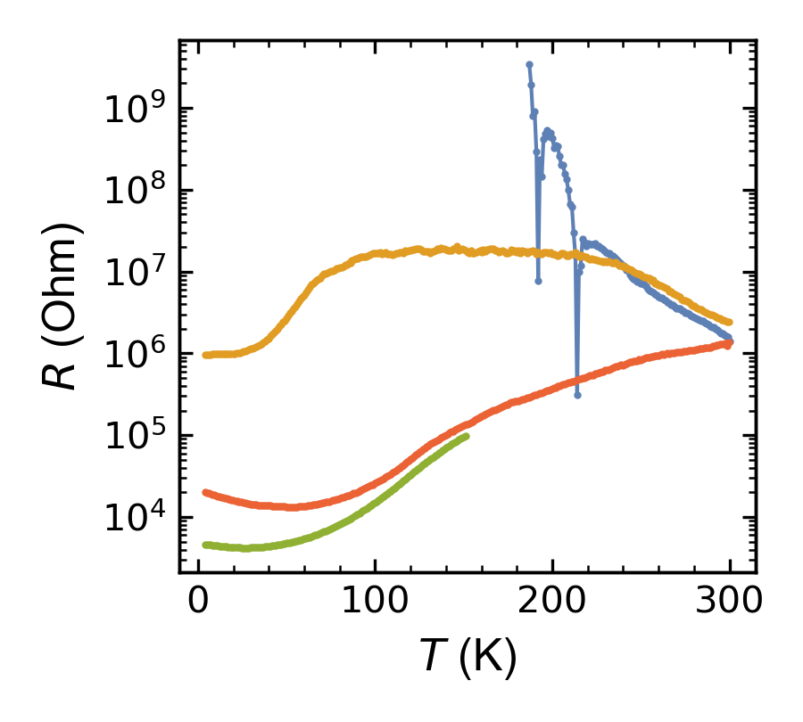
Labels on chart all refer to what the gate voltage was when cooled. All measurements were taken at V_{G} = 75V.
The 75V (cooling/warming) was done with V_{SD} = 1V, the 0V and -75V were done with V_{SD} = .1V.
So even with less SD voltage the 0V and -75V cooling seems to conduct more
75V cool
75V warm
2pt
0V warm
-75V warm
-75V warm
75V cool
0V warm
75V warm
75V warm
4pt
0V warm
75V cool
-75V warm

